Slide 1



Financial Sample
View in Power BI
Last data refresh:
8/2/2022 7:59:16 PM UTC
Downloaded at:
8/22/2022 8:31:39 PM UTC

Slide 2
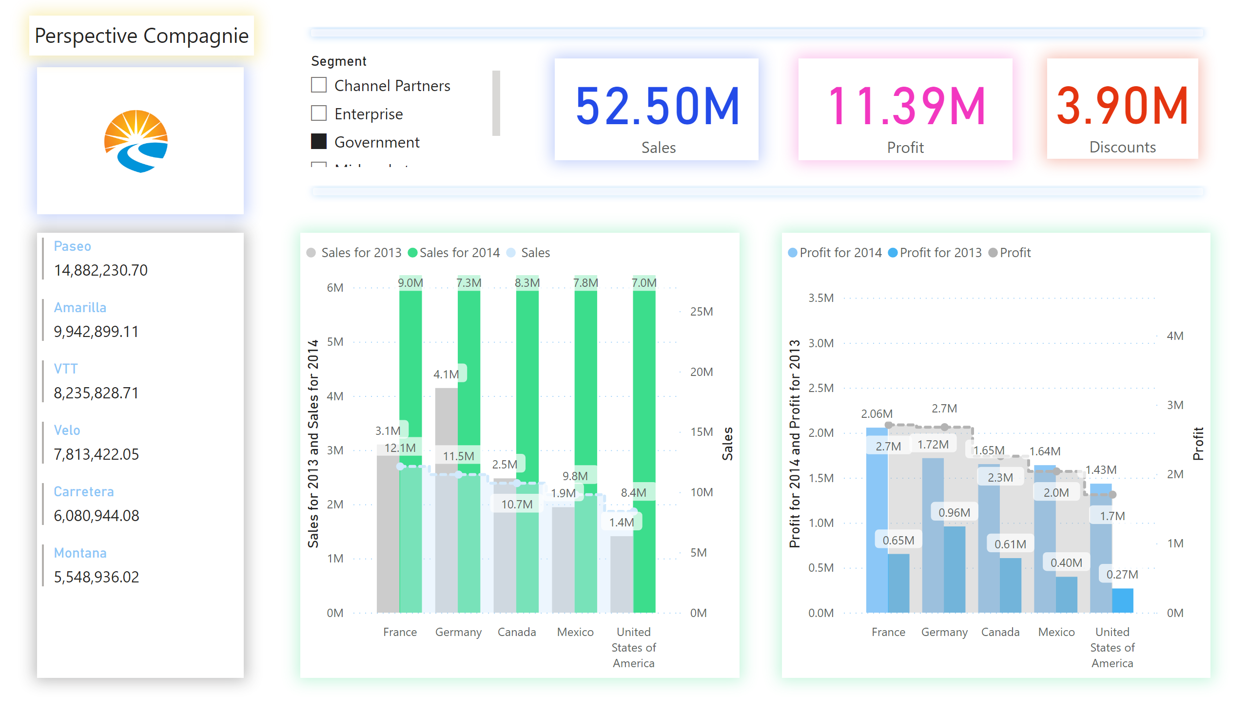
Dashebord
Notes:
lineClusteredColumnComboChart
No alt text provided
lineClusteredColumnComboChart
No alt text provided
card
No alt text provided
card
No alt text provided
card
No alt text provided
slicer
No alt text provided
multiRowCard
No alt text provided
shape
No alt text provided
image
No alt text provided
shape
No alt text provided
textbox
No alt text provided

Slide 3
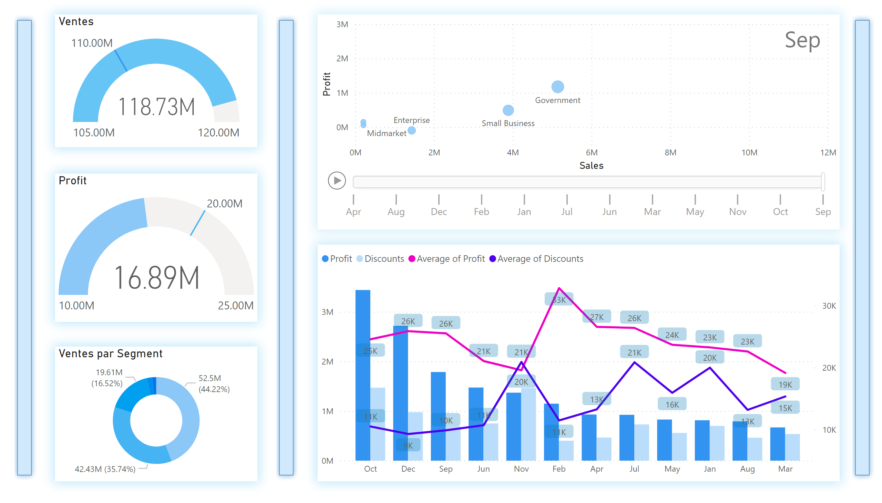
Timing
Notes:
Ventes par Segment
No alt text provided
lineClusteredColumnComboChart
No alt text provided
Ventes
No alt text provided
gauge
No alt text provided
scatterChart
No alt text provided
shape
No alt text provided
shape
No alt text provided
shape
No alt text provided

Slide 4
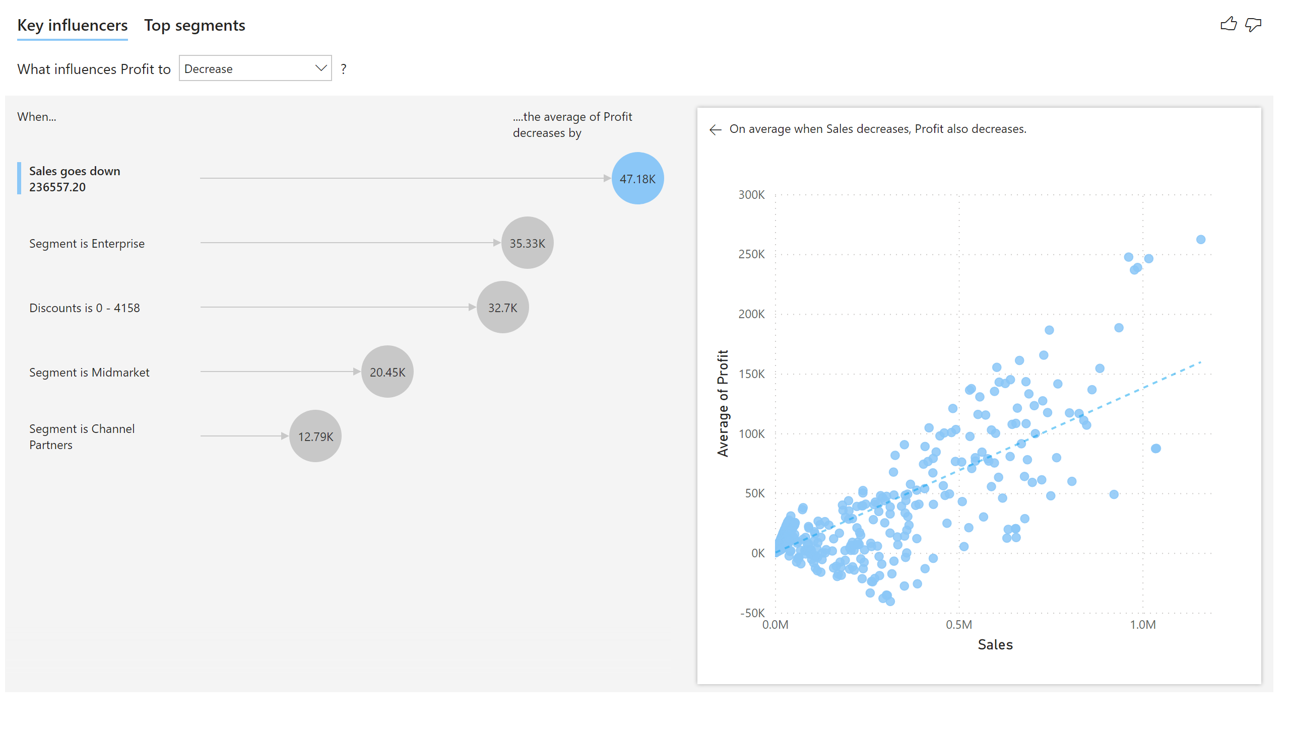
AI
Notes:
keyDriversVisual
No alt text provided

